Slide 1


Empirical Security & Privacy, for Humans
UPenn CIS 7000-010
9/11/2025
Security – Passwords

Slide 2
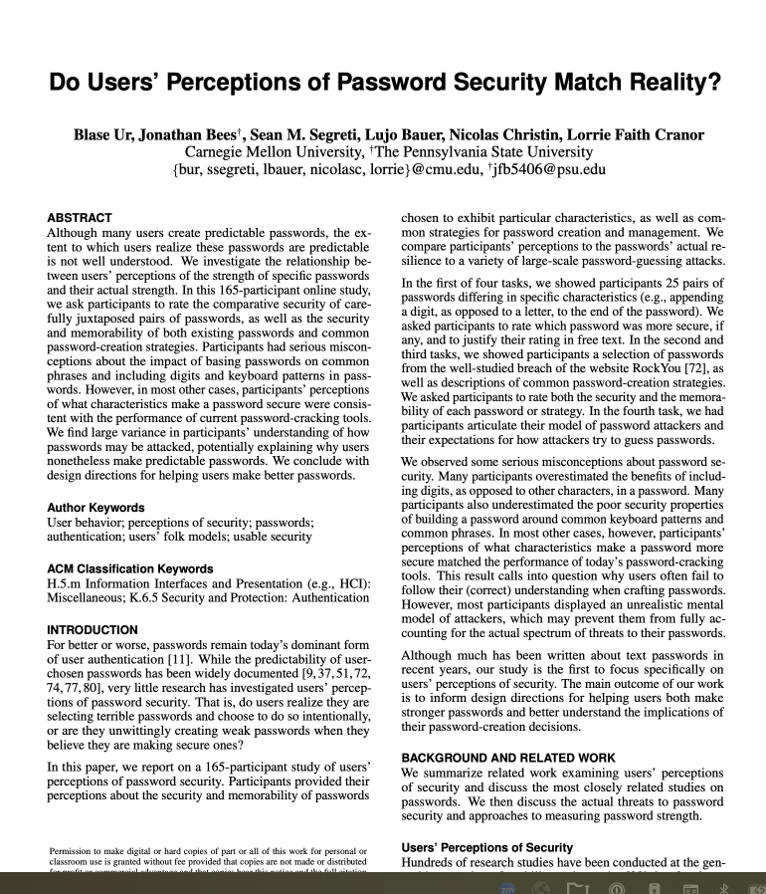
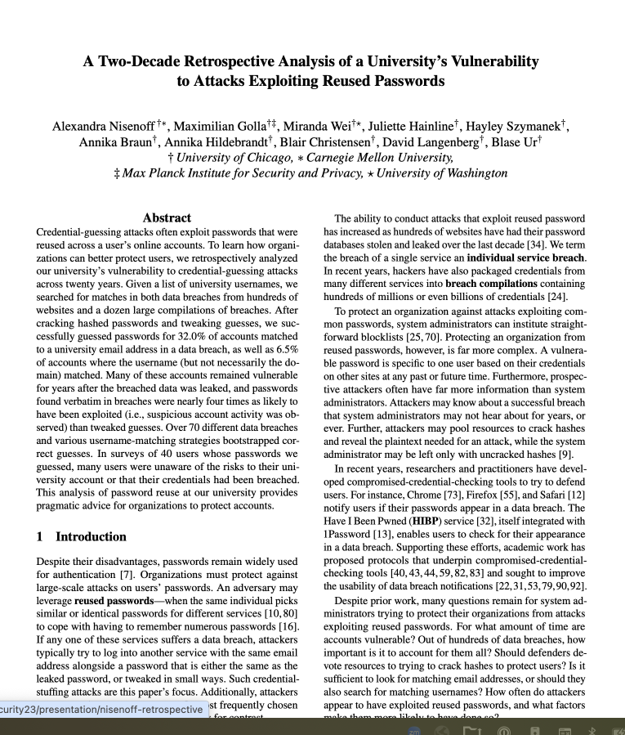
Readings
(optional)

Slide 3
Readings

Slide 4
Password security: Perception vs. reality
Password predictability in 2016 (and today?) is high. Why?
Two hypotheses
Users unwittingly select predictable passwords because they misunderstand what makes a password guessable
Users prioritize memorability, or some other feature, over predictability
Let’s test these hypotheses experimentally!
Recruit participants on Amazon Mechanical Turk
Give them a small set of technical exercises and free-response questions; takes about 30 minutes
Analyze the data, and draw conclusions

Slide 5
Study design: 5 parts
The first part of the study asked about demographics, including age and gender, and if a security professional
Second part: Password pair assessment (comparison)
Third part: Password direct assessment, of security & memorability
Fourth part: Password creation and management strategy assessment
Fifth part: Impressions about attackers
Done last to avoid priming participants

Slide 6
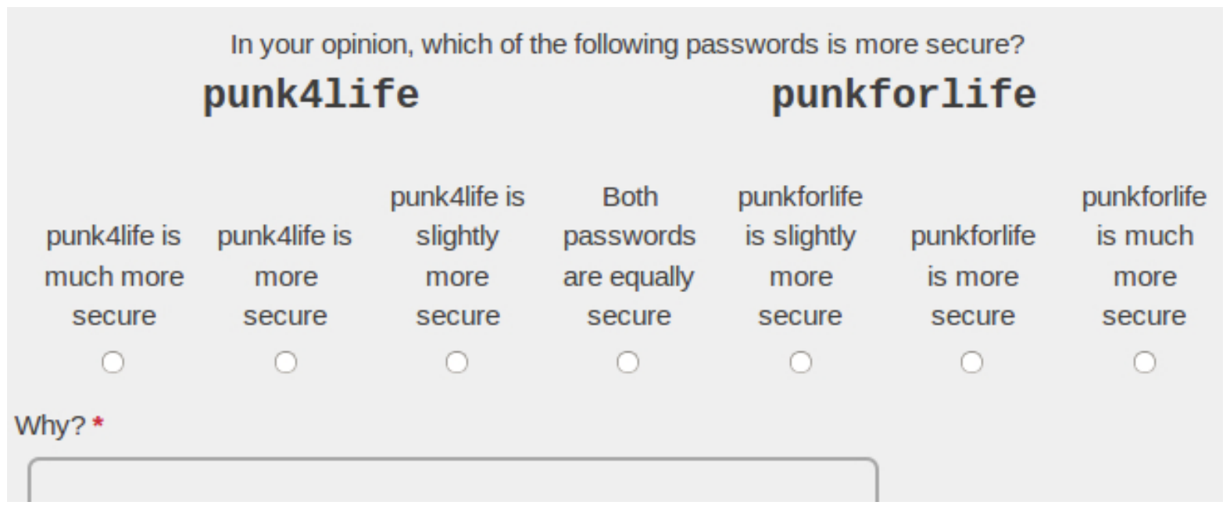
Part 2: Comparison questions
25 kinds of difference, users saw one of three password pairs per category
Password pairs selected randomly/systematically from RockYou dataset (real-world PW DB that was leaked)
26th category is an attention check: Show the same password
Presented in randomized order, and randomized left/right position

Slide 7
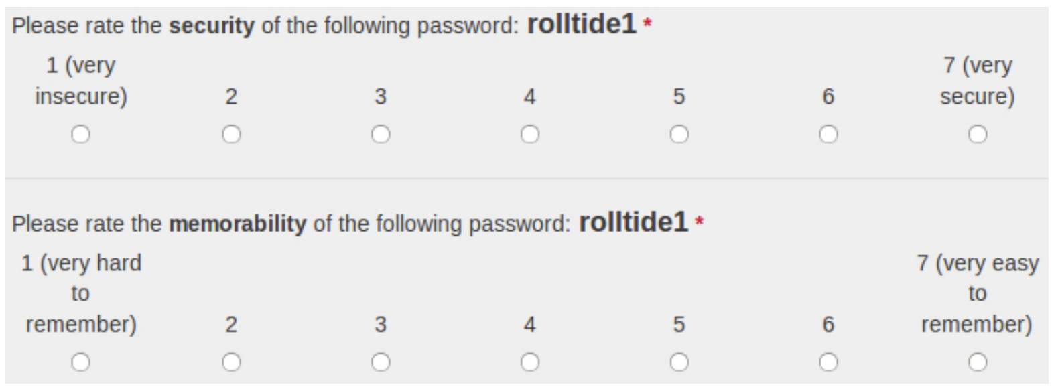
Part 3: Password rating questions
20 passwords selected from the RockYou dataset

Slide 8
Part 4: Strategy rating questions
Similar look to Part 3, but presented the strategy
Chose common strategies from prior work on password creation and password management
Example: create a password “using a phrase taken from the lyrics to a song (e.g., somewhere over the rainbow).”

Slide 9
Part 5: Attacker questions
7 questions with open-ended answers
“what characteristics make a password {easy, hard} for an attacker to guess?”
“describe the type of attacker (or multiple types of attackers), if any, whom you worry might try to guess your password”
…

Slide 10
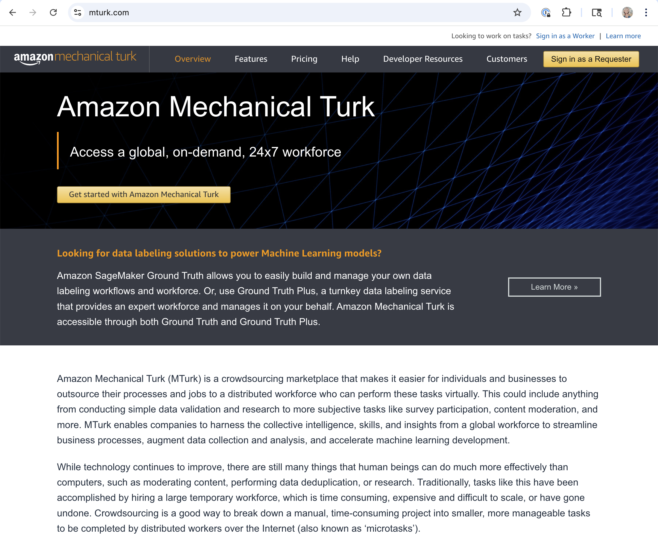
Study participants
165 recruited from Mechanical Turk in USA
Nearly gender-balanced
33 U.S. states.
Age from 18–66
mean age of 34.2 years
median of 33
Few participants had special familiarity with security
Paid $5 to participate

Slide 11
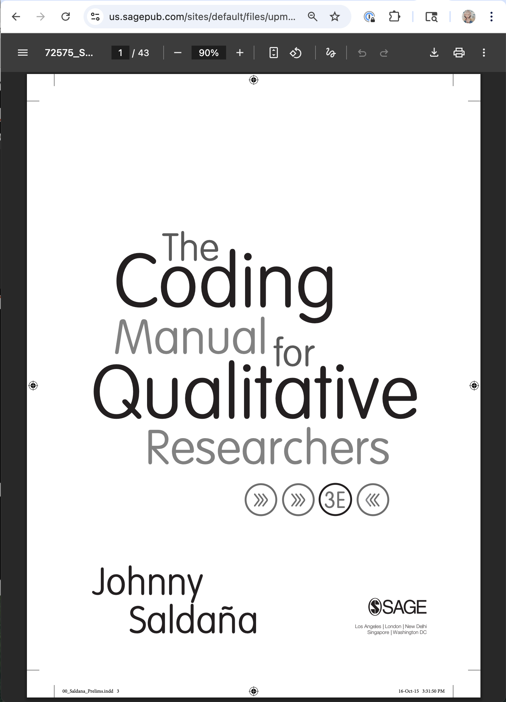
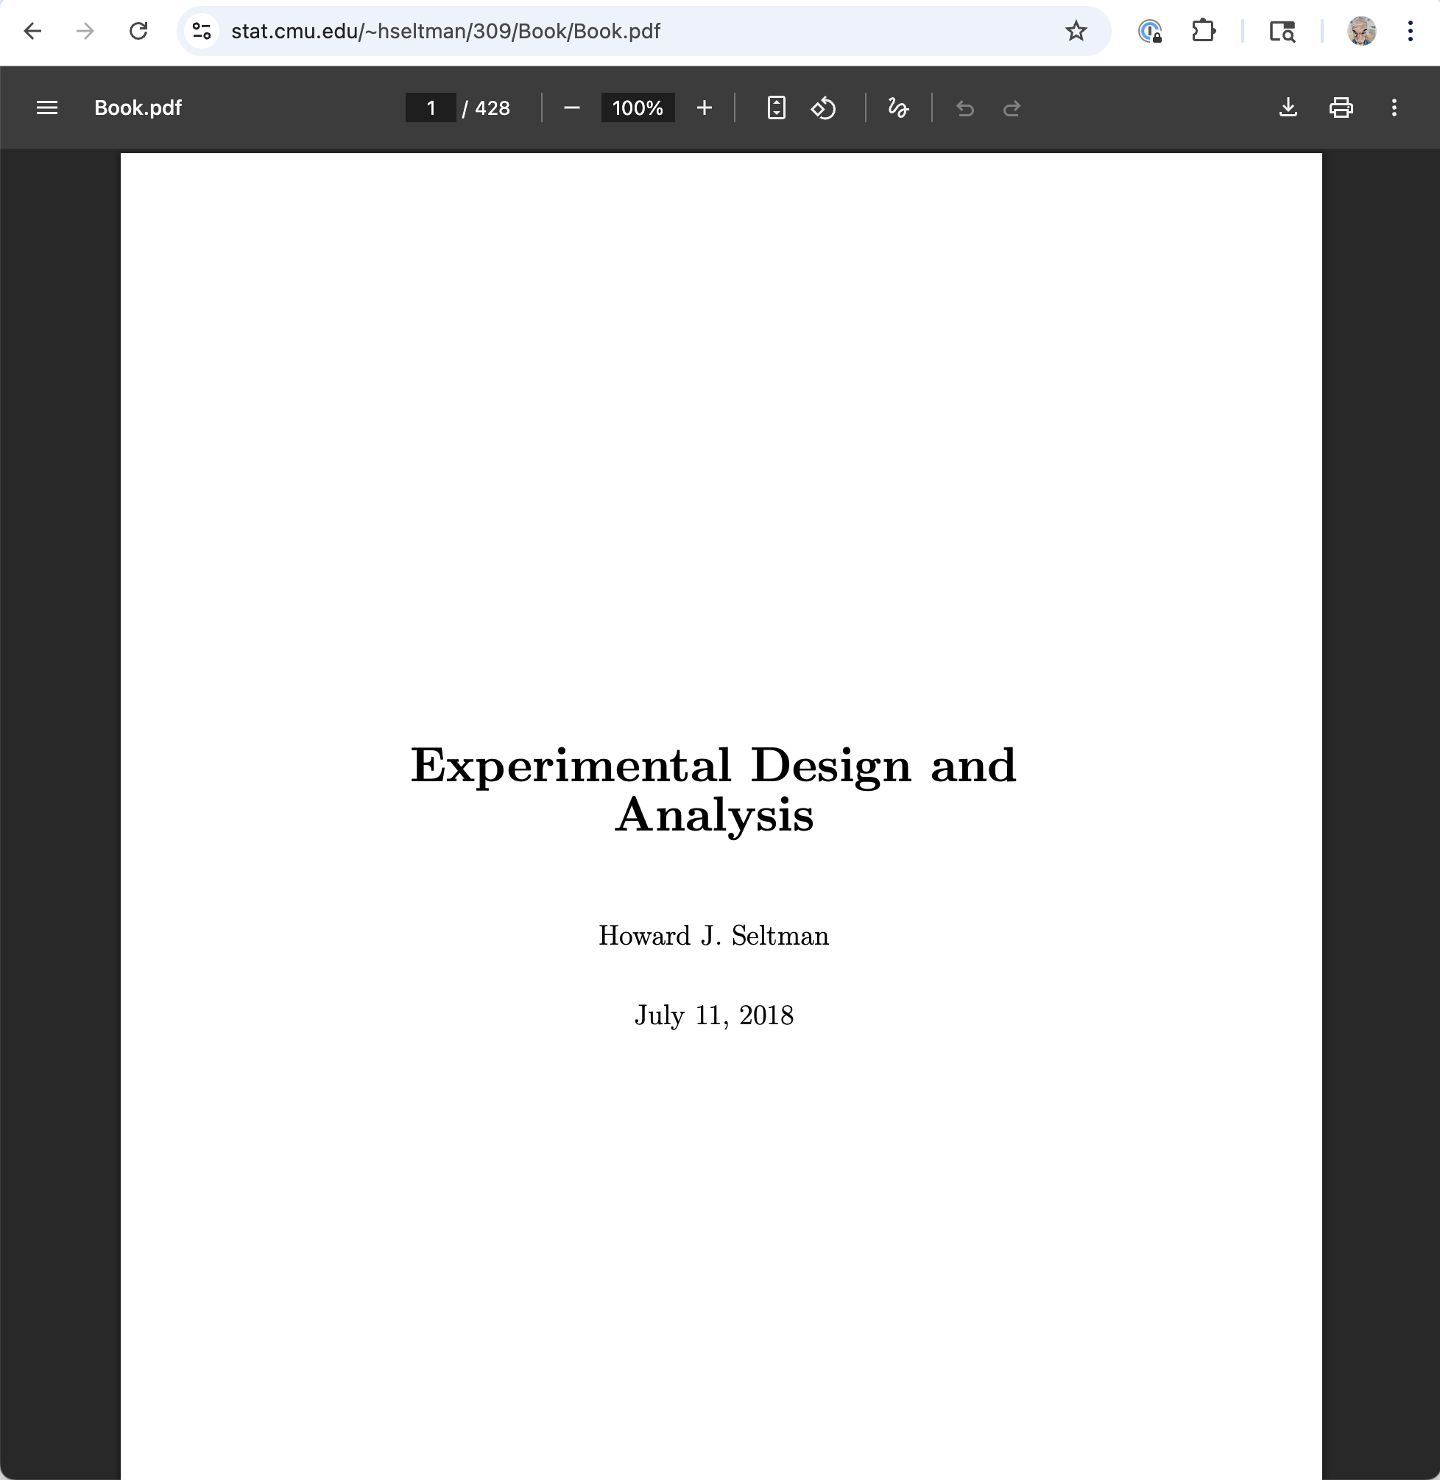
Analysis
Qualitative analysis (text responses)
Quantitative analysis (numeric, Boolean data)
These free books linked from course webpage
Notes:
we coded responses to the seven questions about attacker models, as well as all password pairs where participants’ perceptions differed statistically significantly from the guess numbers we calculated. One member of the research team first read through all responses to a question and proposed codes that would capture common themes. This researcher then coded all responses and updated the codebook when necessary. A second coder used the annotated codebook to independently code the data. Intercoder agreement ranged from 85.0% to 91.4% per question, while Krippendorff’s α ranged from 0.80 to 0.88. The coders met, discussed discrepancies, and agreed on the final codes.

Slide 12
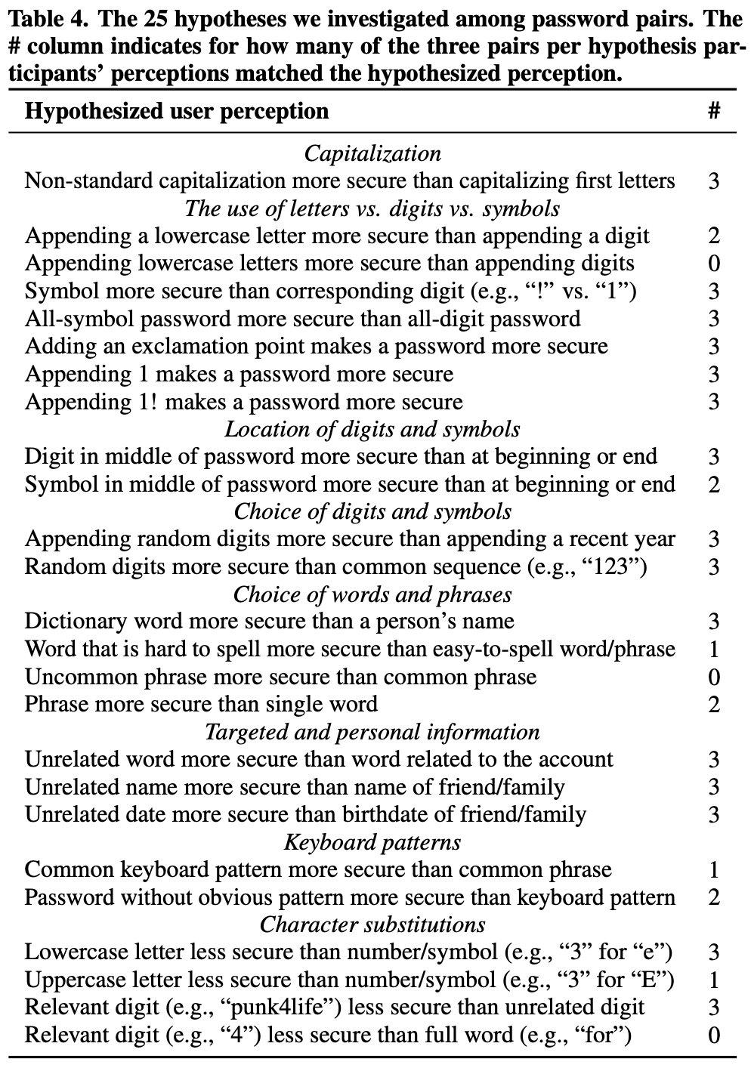
Results: Comparison
59 pairs (79%) were consistent with the performance of current password-cracking approaches. Characterized practices:
capitalizing the middle of words, rather than the beginning
putting digits and symbols in the middle of the password, as opposed to the end
using random-seeming digit sequences, rather than years or obvious sequences
using symbols in place of digits
preferring dictionary words over common first names
avoiding personal content (e.g., a relative’s name)
avoiding terms related to the account (e.g., “survey” for an MTurk password)
Notes:
We treated participants’ rating for each password pair {PW1, PW2} as an ordinal rating from -3 to 3, where -3 indicates the perception that PW1 is much stronger and 0 indicates that the passwords are equally strong. To test whether participants tended to rate one password in the pair as stronger than the other, we used the one-sample, two-sided Wilcoxon Signed-Rank test. This non-parametric test evaluates the null hypothesis that the true password rating is 0 (equally secure) and the alternative hypothesis that the true rating is non-zero (one password is perceived more secure than the other).
Non-parametric: No assumption about normality of distribution
Two-sided: test is non-equality, rather than greater or less
Since the ordinal rating of 0 means “equally secure”, this is testing whether one is more secure than the other, in either direction
Seems weird? If participants were all over the map, but never 0, this would indicate a difference?
Takeaway: 59 pairs (79%) were consistent with the performance of current password-cracking approaches.
Stats question: What does the following mean?
For all tests, we set α = .05. We corrected for multiple testing using the conservative Bonferroni method, which we applied per type of test (e.g., we multiplied p values by 75 for the 75 password pairs).

Slide 13
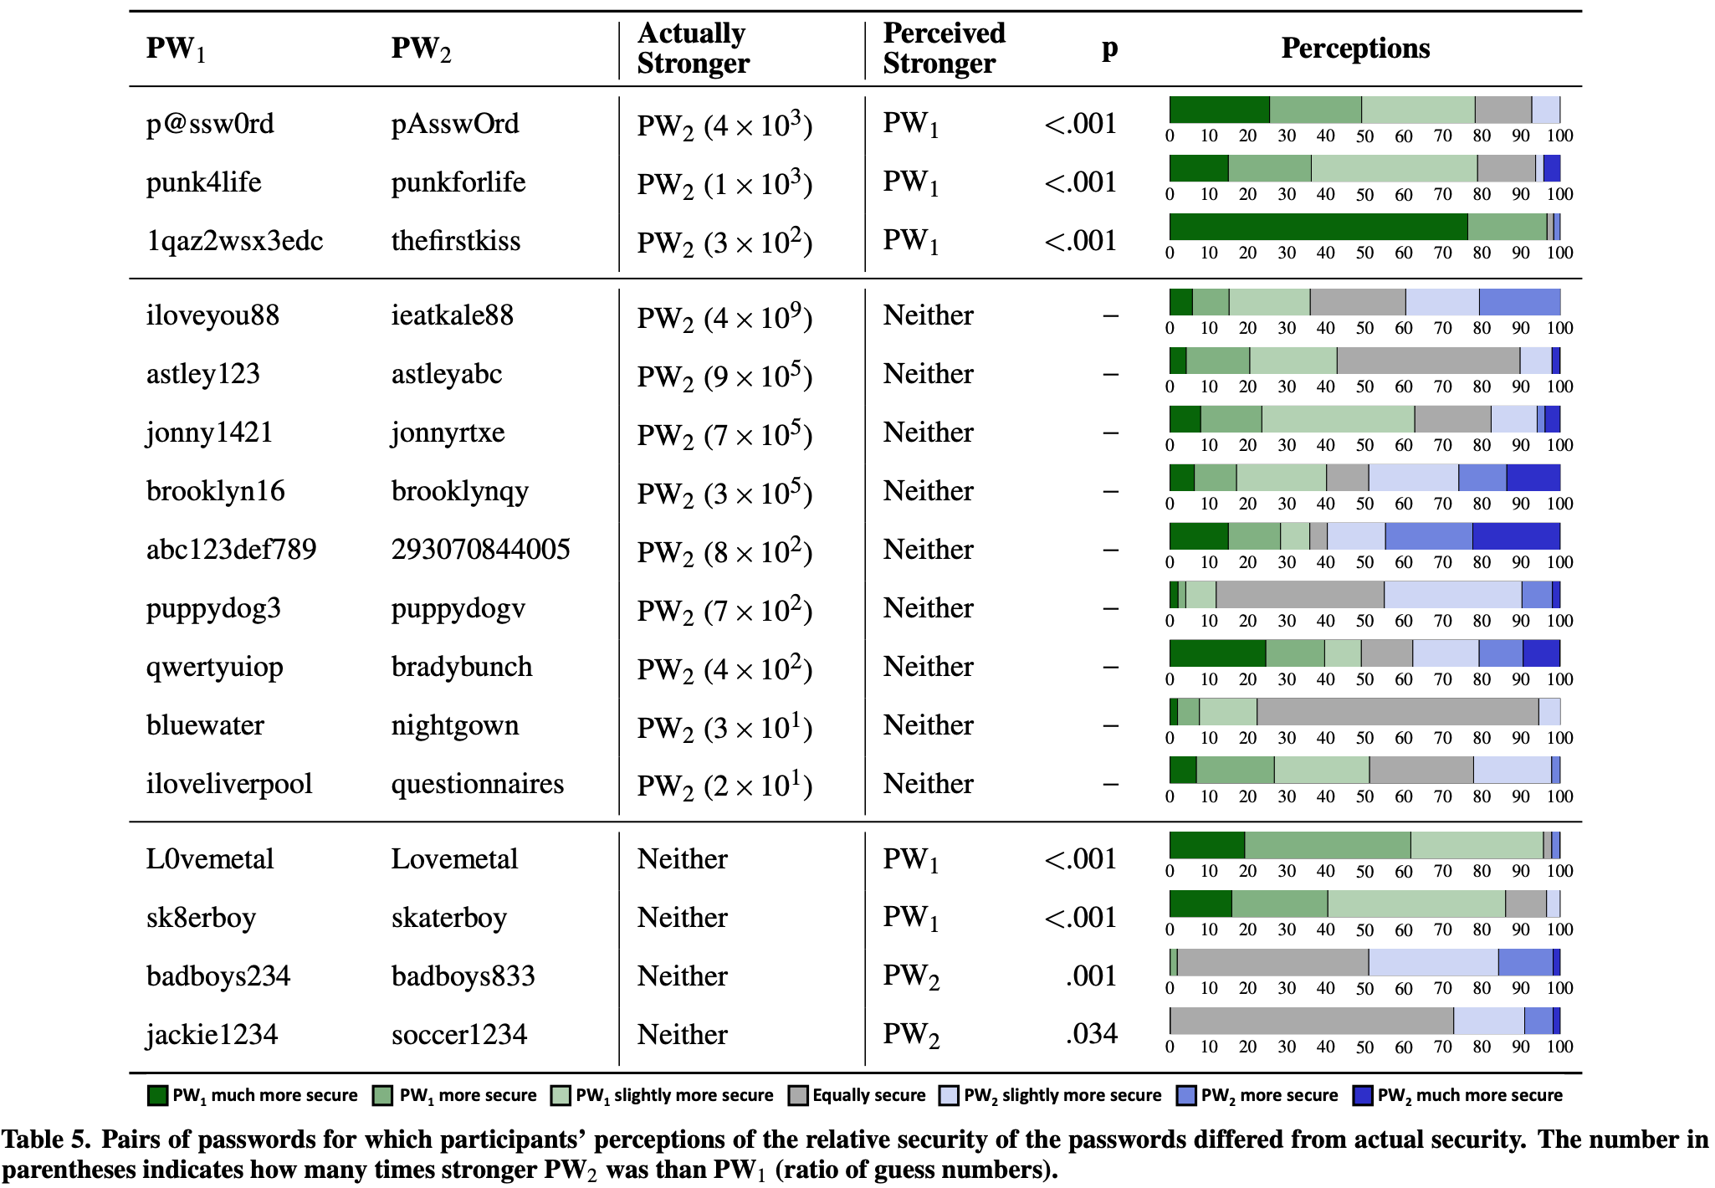
Results: Comparison
16 pairs (21%) were not consistent.
Misconceptions:
adding digits inherently makes a password more secure than using only letters
substituting digits or symbols for letters makes a password more secure
overestimated the security of keyboard patterns
misjudged the popularity of particular words and phrases

Slide 14
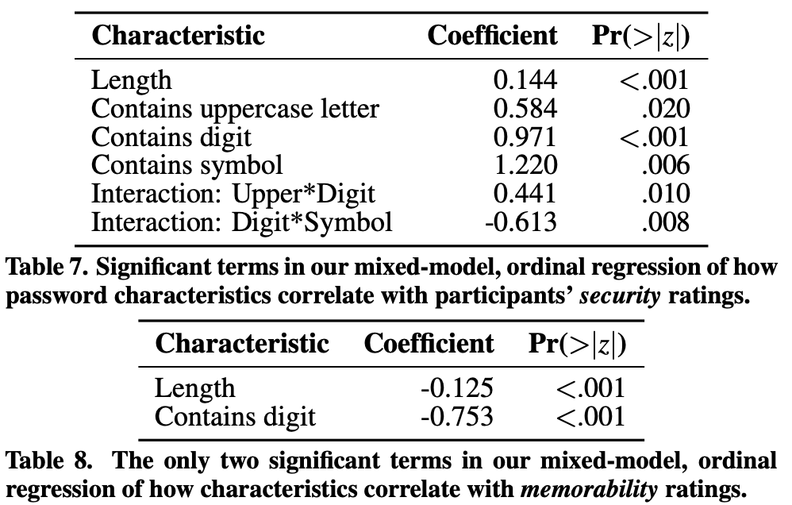
Results: Direct assessment
Regression models correlating characteristics with security or memorability
Participants’ memorability ratings were inversely correlated
with strength ratings (Spearman’s ρ = −0.678, p<.001).
Notes:
To investigate the relationship between security and memorability for the selected-password analysis and password creation strategies, we calculated Spearman’s rank correlation coefficient (Spearman’s ρ), which is a nonparametric evaluation of the correlation between variables. The value for ρ varies between 1 (perfect correlation) and -1 (perfect inverse correlation), where 0 indicates no correlation.
What is the Pr(>|z|) part?
For our selected-password analysis, we also used regression models to evaluate the relationship between numerous independent variables (e.g., password length, number of digits) and participants’ ratings of password security and memorability. In particular, because participants’ ratings were ordinal on a 7-point scale and because each participant rated 20 different passwords, we use a mixed-model ordinal regression.

Slide 15
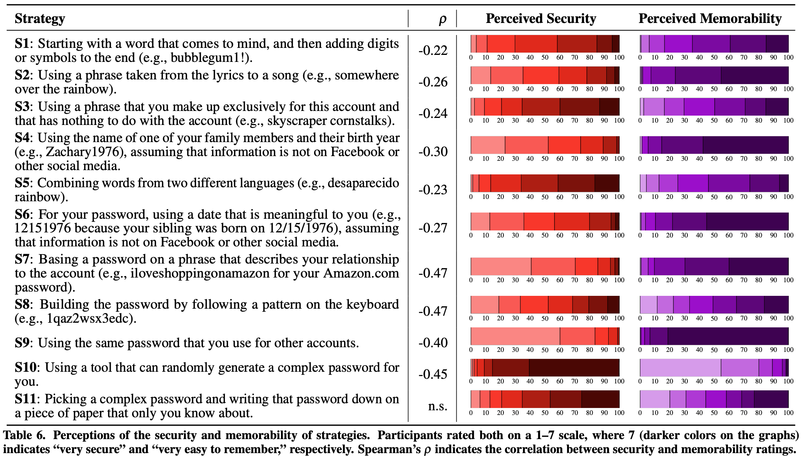
Results: Strategy
Notes:
calculated Spearman’s rank correlation coefficient (Spearman’s ρ), which is a nonparametric evaluation of the correlation between variables. The value for ρ varies between 1 (perfect correlation) and -1 (perfect inverse correlation), where 0 indicates no correlation.
I’m confused! Why is S8 not positive?

Slide 16
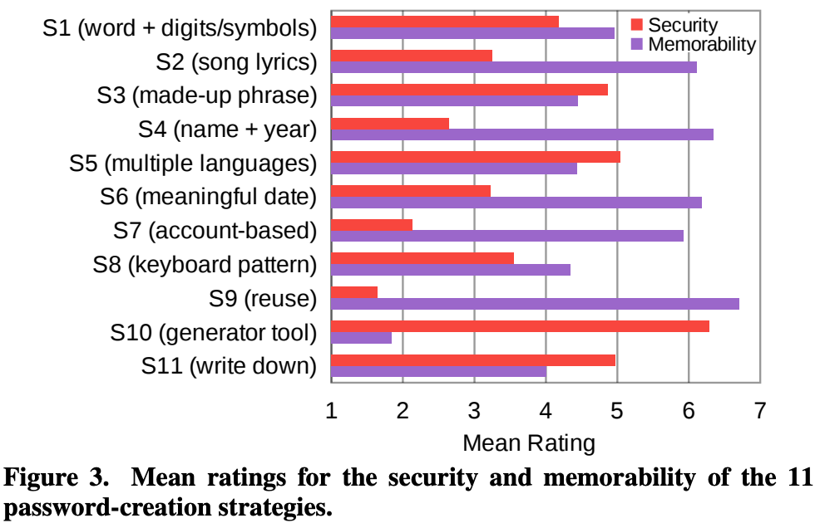
Results: Strategy

Slide 17
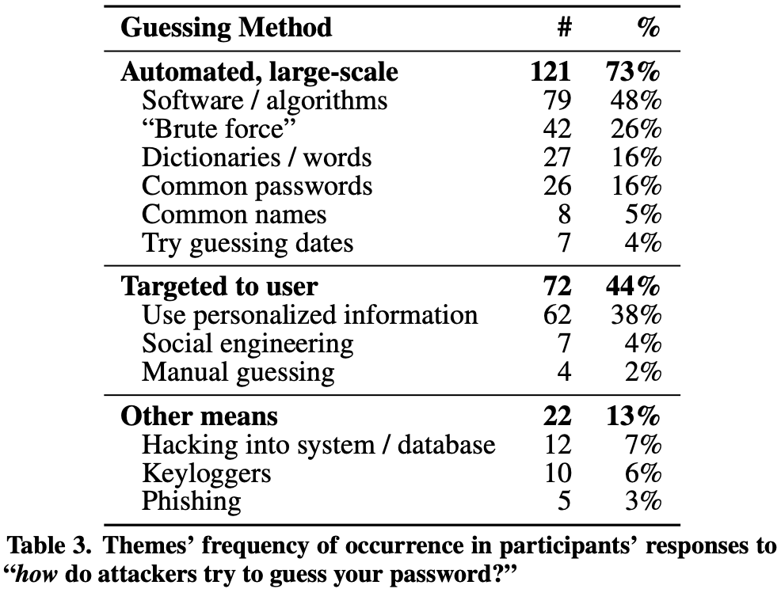
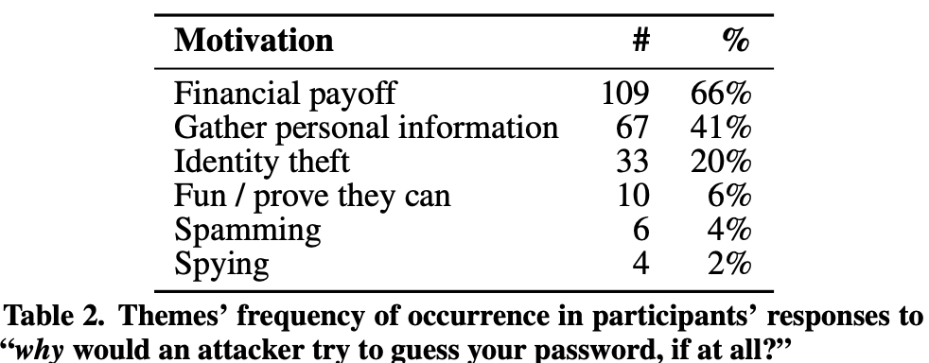
Results: Attacker characterization

Slide 18
Themes, discussion points
What are the limitations of this study? Why might its conclusions be wrong?
E.g., technical issues with the data analysis, choice of participants, etc.
User perceptions were mostly in line with good practices. Why, then, are passwords in the wild generally predictable?
What interventions might improve the situation? How would we test them?
Notes:
Users’ incomplete understanding of the scale of potential attacks thus seems to be a root cause of bad passwords. As we surveyed in the background section, the spectrum of threats to passwords is complex and nuanced. For instance, a password’s resistance to large-scale guessing matters mostly if the user reuses that password for other accounts [26] or if the service provider fails to follow security best practices. Following the principle of defense in depth, users should protect themselves against all likely attackers, which is why security
experts often recommend using password managers to store unique passwords for each account

Slide 19
Readings
Talk video and PDF of slides at https://www.usenix.org/conference/usenixsecurity23/presentation/nisenoff-retrospective
(optional)

Slide 20
Summary results
Guessed 32% of passwords in historical DB by leveraging reuse
As compared to 6.5% without considering reuse
35.5% of valid guesses were for current passwords
Of those guessed by reuse
54.7% were verbatim reuse, vs. 45.3% based on tweaks
Vulnerability is real
Some historical observed exploits seemed to coincide with data breaches
Passwords were vulnerable for long after a breach (median of 5 years)

Slide 21
Discussion points
Ways that the study leveraged the historical password database
Ethics concerns
Technical challenges
What the study might have missed or overstated (limitations)
Other inferences to draw from results
Recommendations, and relevance today
Thoughts?

Slide 22
END

